Slide 1
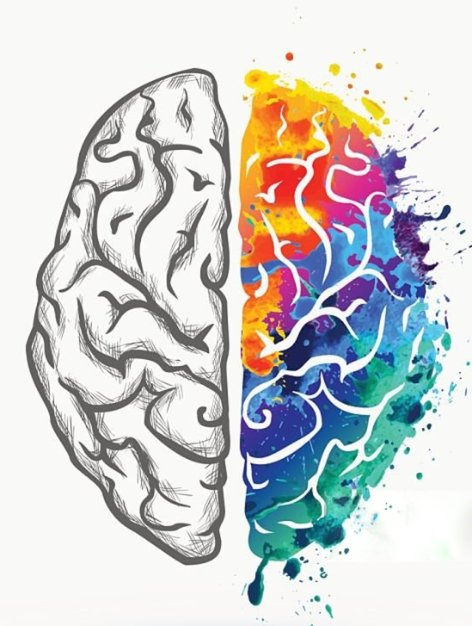
Brain Development
Chad Williams
University of Victoria

Slide 2
Lecture Outline
Stages of Development
Development and Experience
Epigenetics and Experience

Slide 3
Lecture Outline
Stages of Development
Development and Experience
Epigenetics and Experience

Slide 4
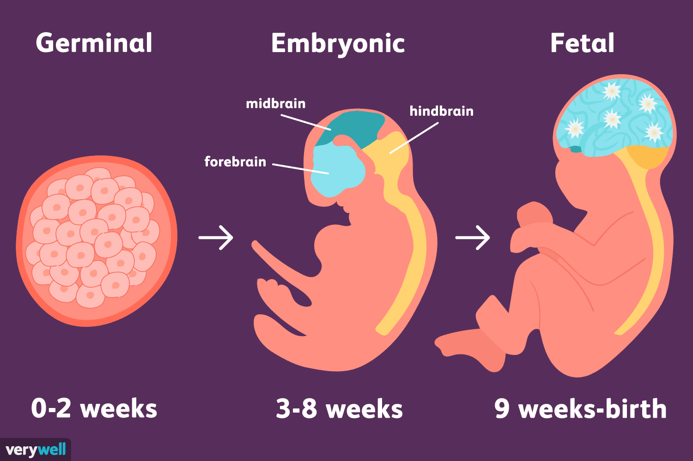

Slide 5
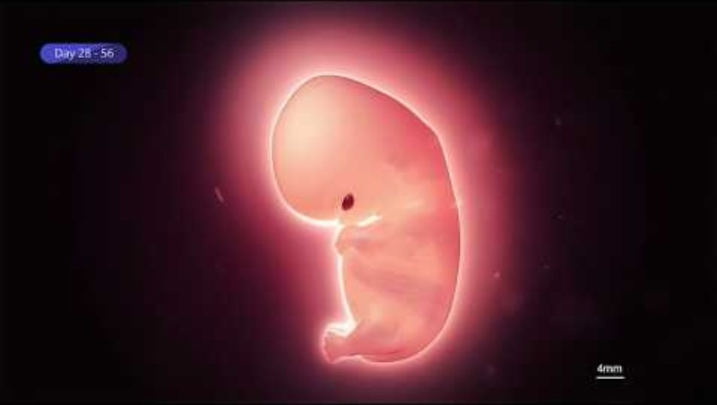

Slide 6
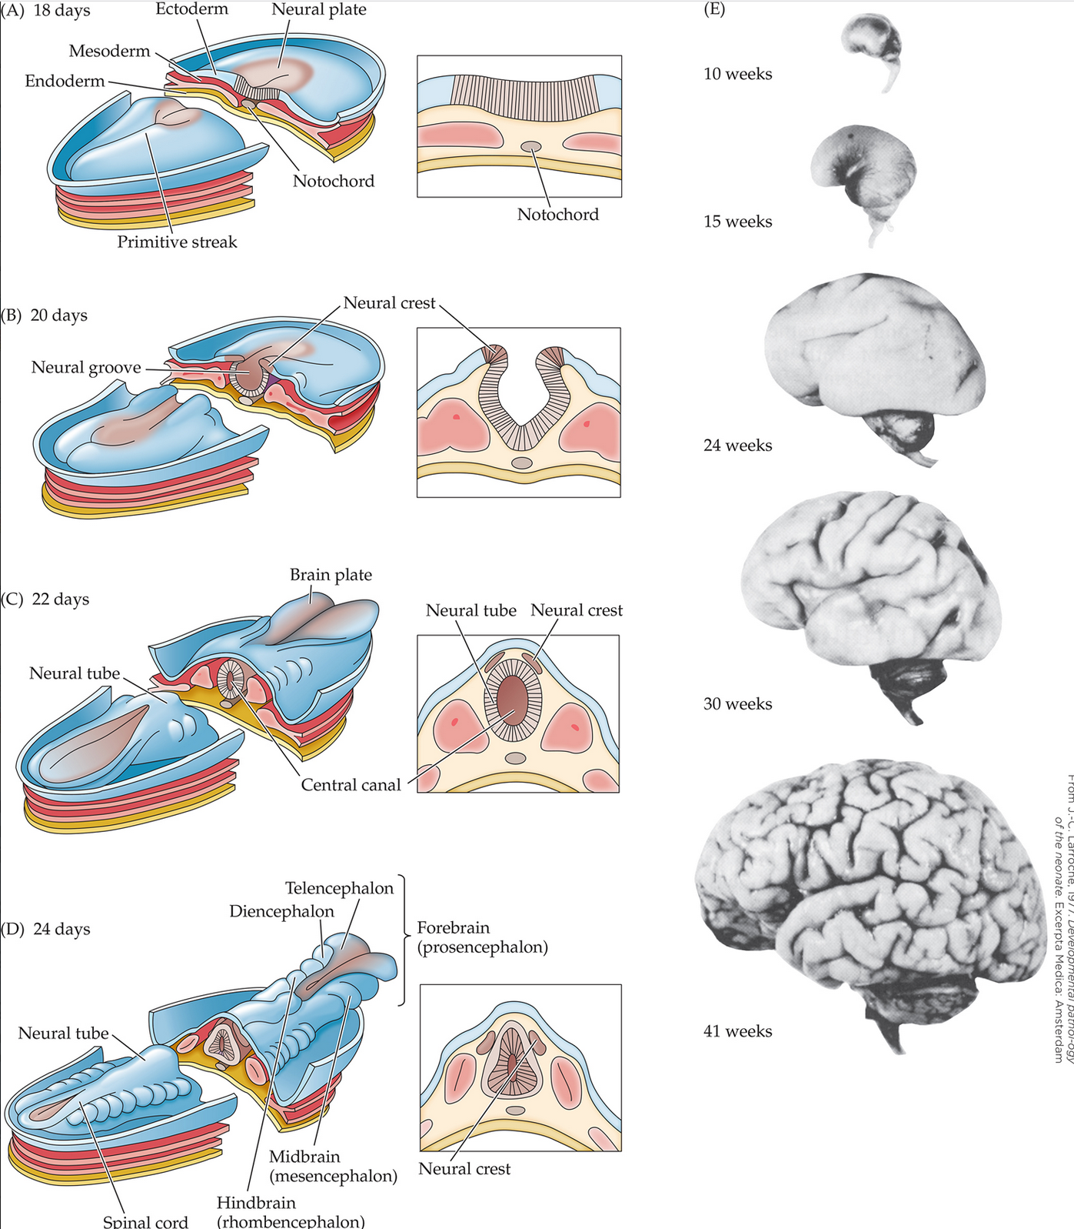
Embryonic Stage of Development
18 Days: Embryo implants in uterine wall
Endoderm: Forms many internal organs and structures
Gives rise to tissues such as the digestive tract, liver, pancreas, and lungs
Mesoderm: Forms muscles, bones, connective tissue, and blood
Also contributes to the circulatory system
Ectoderm: Forms the skin and nervous system
The nervous system develops from a specialized region of the ectoderm called the neural plate
20 Days: Ectoderm thickens to form the neural plate
Plate folds inward to create the neural groove

Slide 7
Embryonic Stage of Development
22 Days: The neural crests of the groove fuse to form neural tube
Neural Tube: Develops into the central nervous system (brain, spinal cord)
Neural Crest: Develops into the peripheral nervous system (sensory neurons, autonomic nervous system)
24/25 Days: Neural tube forms into three major divisions of the brain
Forebrain: Develops into structures such as cerebral cortex and thalamus
Responsible for higher cognition, perception, emotion, and voluntary behaviour
Midbrain: Develops into regions involved in low-level sensory processing and motor control regions
Important for visual and auditory reflexes
Hindbrain: Develops into structures such as cerebellum and medulla
Controls coordination, balance, and other vital functions

Slide 8
Fetal Stage of Development
Neurogenesis
Cell migration
Differentiation
Synaptogenesis
Neuronal cell death
Synapse rearrangement

Slide 9
Fetal Stage of Development
Fetal Stages of Development
The timeline of these six stages are broad and heavily overlap
For example, neuronal cell death occurs throughout development
Although it is especially prominent during periods of synaptogenesis and circuit refinement
Many developmental stages continue after birth as neural circuits mature

Slide 10
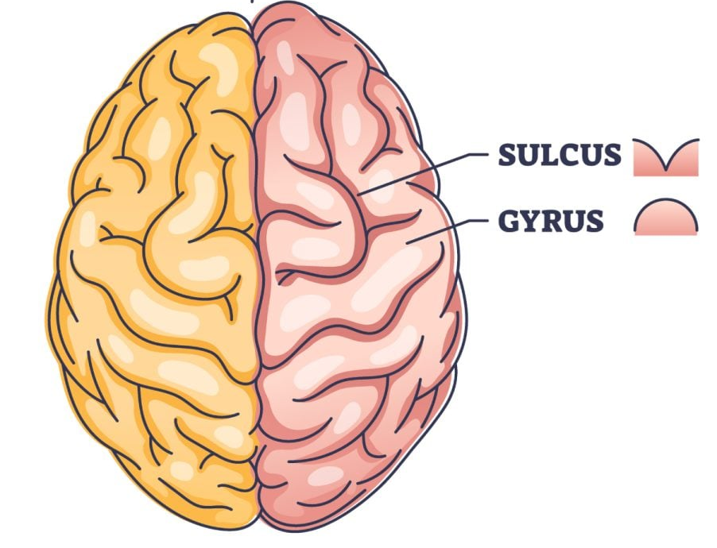
Fetal Stage of Development
10 Weeks: Brain is smooth and small
Development Stage: Neurogenesis
Major divisions of the brain are established
Early cranial nerves and primitive reflex pathways formed
15 Weeks: Brain increases in size
Development Stage: Cell migration and differentiation
Early cortical organization begins
24 Weeks: Brain continues to grow
Development Stage: Synaptogenesis and neuronal cell death
Early cortical folding
Sensory systems are becoming increasingly functional

Slide 11
Fetal Stage of Development
30 Weeks: Major increase in cortical folding
Development Stage: Synaptogenesis and neuronal cell death
Neural connections become more complex
Early myelination begins in some pathways
41 Weeks: Cortical folding matures with extensive gyri and sulci
Development Stage: Synapse rearrangement begins
Many neural pathways are established
Brain is functional but immature at birth

Slide 12
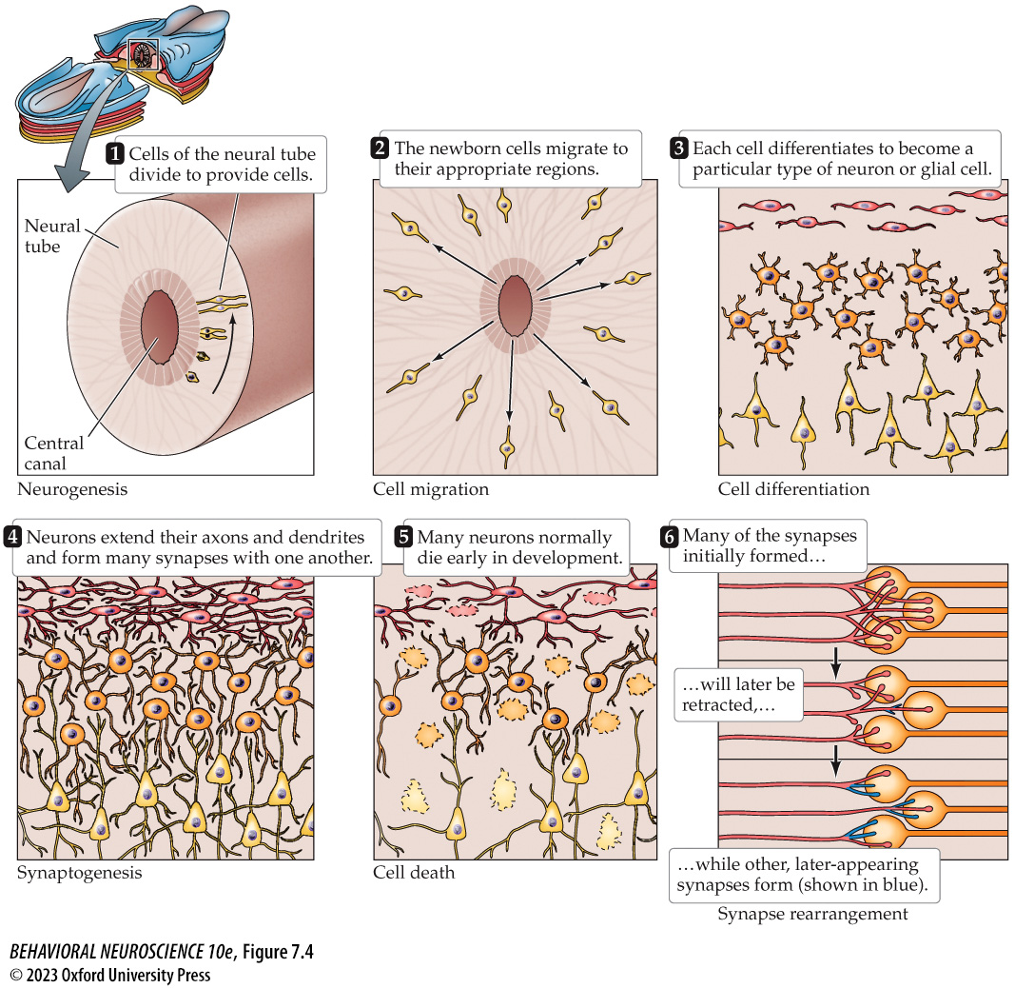
Fetal Stage of Development
Neurogenesis
Cell migration
Differentiation
Synaptogenesis
Neuronal cell death
Synapse rearrangement

Slide 13
Fetal Stage of Development
Neurogenesis: The mitotic division of nonneuronal cells to produce neurons
Neurons arise from precursor cells that divide and form the ventricular zone
These cells will differentiate into neurons or glial cells
Precursor cells stop dividing at predictable embryonic stages

Slide 14
Fetal Stage of Development
Adult Neurogenesis: A minority of new neurons can form in adulthood to replace neurons that have died
Triggered by learning and physical exercise
Impeded by stress and negative social interaction
Mostly in the hippocampus and olfactory bulb
Early evidence that it occurs across the brain
Still controversial

Slide 15
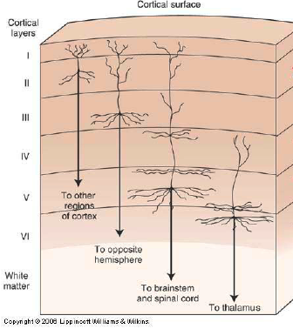
Fetal Stage of Development
Cell Migration: The movement of newly formed neurons from the ventricular zone to their final destinations
Occurs primarily during prenatal development
Movement mostly follows radial glial cells
Migrations occur in waves with each wave forming a new layer
Six waves form the six layers of the cerebral cortex

Slide 16
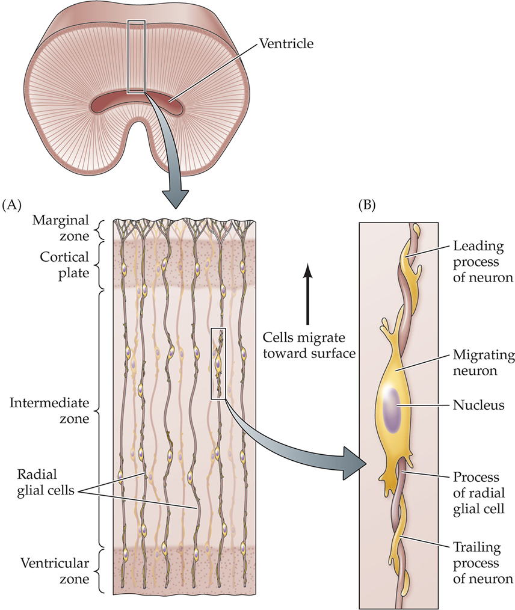
Fetal Stage of Development
Cell Migration
Cell adhesion molecules (CAMs) guide migration and axon growth
They are proteins attached to the outer membranes of radial glial cells
They allow neurons to attach to and detach from radial glial fibers
This helps guide neurons toward their proper destinations in the developing nervous system

Slide 17
Fetal Stage of Development
Differentiation: Gene expression transforms cells into neurons or glial cells through the production of specific proteins
Differentiation is complex and flexible
Multipotent: Cells have potential to become a range of neurons and glial cells
Induction: Local environment (e.g., neighbouring cells) majorly influence and guide differentiation
Regulation: Other cells will replace an injured or lost cell

Slide 18
Fetal Stage of Development
Differentiation
Stem Cells: Cells that have not undergone extensive differentiation
They can replace lost cells because they can differentiate appropriately in response to local signals
Stem cells may be used to treat certain disorders
E.g., neurodegenerative disorders, brain injury
Stem cells can be obtained from embryonic and fetal tissues, umbilical cord blood, or unused embryos produced through in vitro fertilization
Adult cells can be treated to replicate stem cells

Slide 19
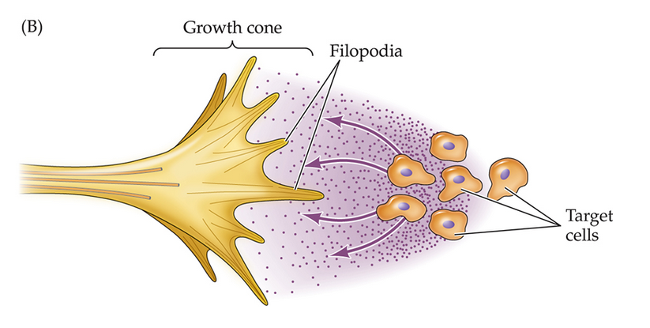
Fetal Stage of Development
Synaptogenesis: Extensive growth of axons and dendrites
Growth cones with filopodia that form at the end of these appendages
Filopodia extend outward and attach to CAMs, pulling the growth cone forward
CAMs are on diverse cellular surfaces
E.g., glial cells, other axons, target cells
Chemoattractant: Guides where to go
E.g., towards target cell
Chemorepellents: Guides where not to go
e.g., stops from crossing hemispheres
Myelination: The induction of glial cells to form myelin around axon
Occurs once axon reaches destination

Slide 20
Fetal Stage of Development
Neuronal Cell Death (Apoptosis):
Within brain and spinal cord, many neurons die during prenatal development
Survivability of a neuron is driven by the number of target cells
Neurons compete for synaptic connection with target cells
A connection causes the intake of neurotrophic factors and the degree of intake determines likelihood of survival
Neurotrophic factors: Secreted signaling proteins

Slide 21
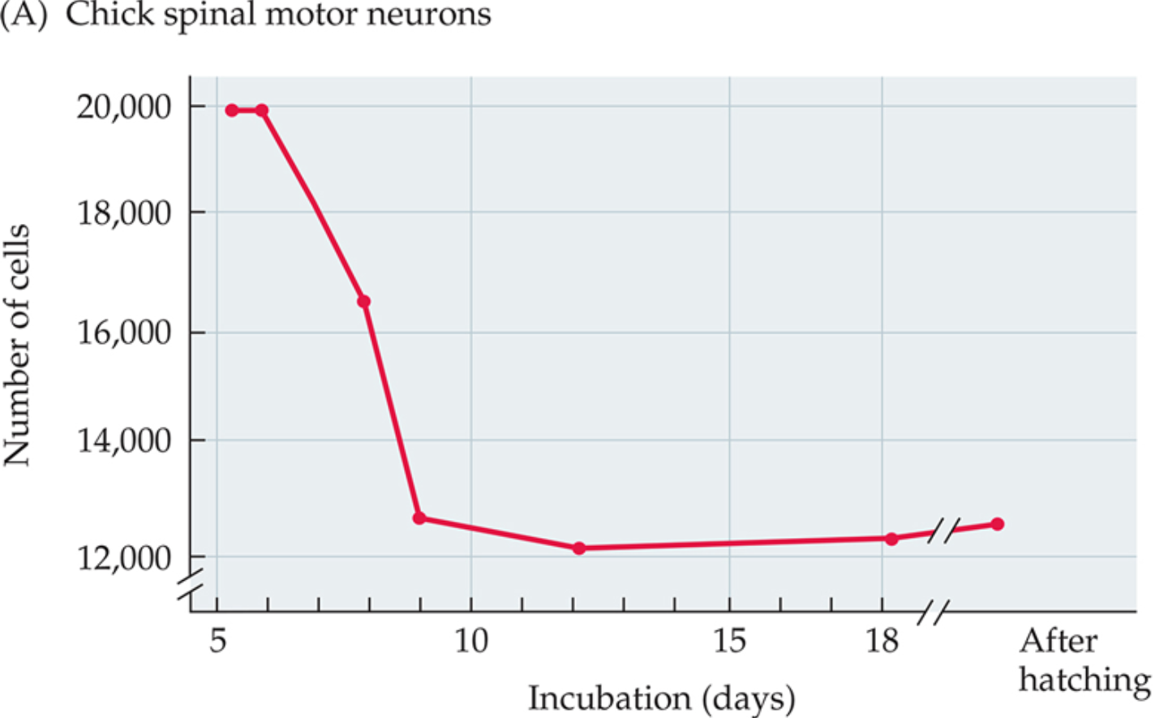
Fetal Stage of Development
Neuronal Cell Death (Apoptosis):
Hamburger, 1975
Research Question: During development, is there a period in which large numbers of neurons die?
Method: Counted motor neuron nuclei in chick embryos at different developmental stages
IV: Developmental age (incubation days/stages)
5.5 days–posthatch
DV: Number of surviving motor neurons

Slide 22
Fetal Stage of Development
Neuronal Cell Death (Apoptosis):
Hamburger, 1975
Results: Exponential decline in surviving neurons
Death occurs early in prenatal development
Approximately 40% of motor neurons die
Conclusion: Early development produces excess neurons
Many neurons are later eliminated through programmed cell death (apoptosis)
Only neurons that form appropriate connections survive

Slide 23
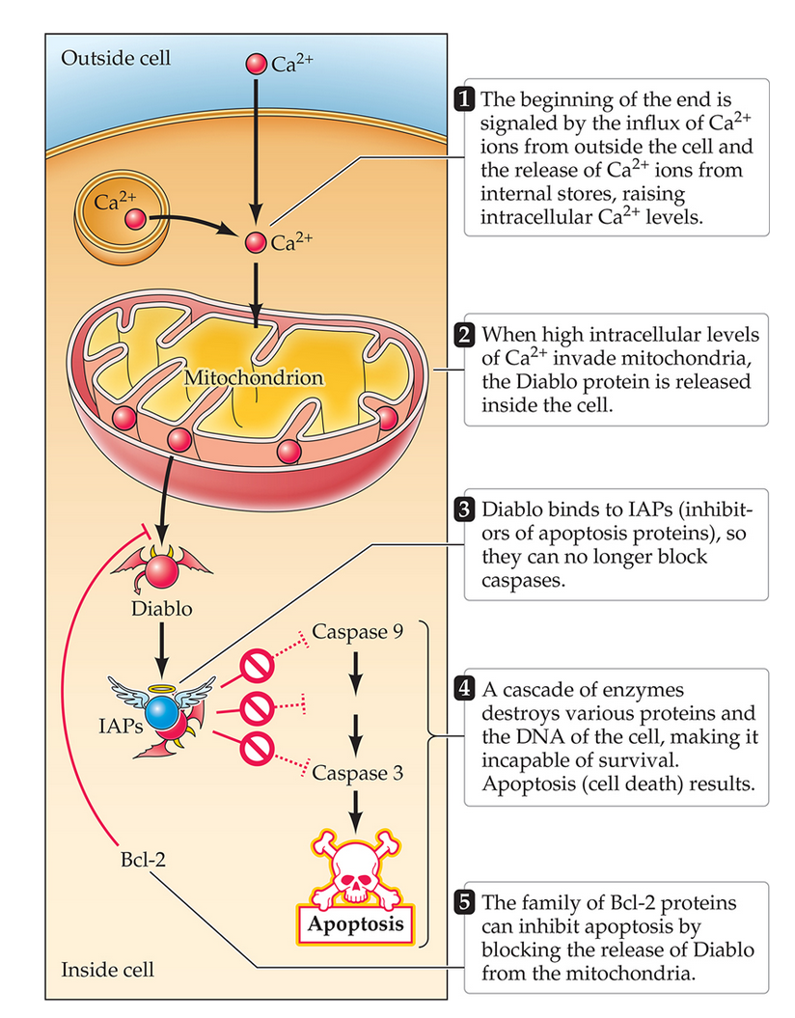
Fetal Stage of Development
Neuronal Cell Death (Apoptosis):
Cell death regulated by death genes, which activate caspases
Influx and release of Ca²⁺ causes mitochondria to release the Diablo protein
Influx of Ca²⁺ is caused by many factors such as cellular stress, membrane damage, lack of neurotrophic factors
Diablo proteins disable inhibitors of apoptosis proteins (IAPs)
Reduced IAP activity allows caspases to become activated
Caspases are enzymes that break down cellular proteins and DNA, leading to apoptosis

Slide 24
Fetal Stage of Development
Synapse Rearrangement: Synaptic connections are pruned, rearranged, and proliferated
Pruning: Elimination of a synapse
Rearrangement: Movement of a synapse
Proliferation: Formation of new synapses
Features:
Fine tunes communication
Affects axon and dendrite connectivity
Especially prominent in cerebral cortex, cerebellum, the brainstem, and the visual cortex

Slide 25
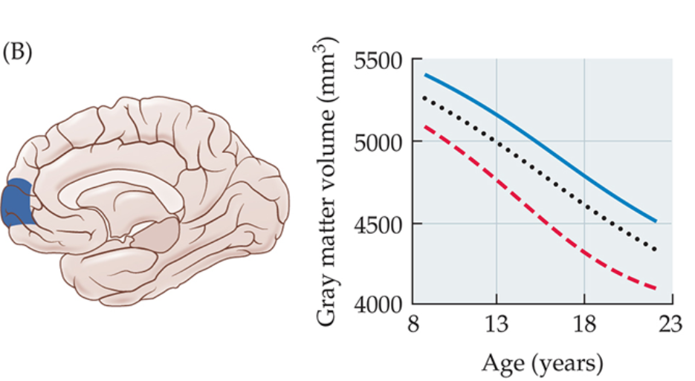
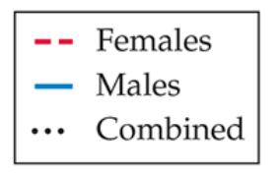
Fetal Stage of Development
Synapse Rearrangement
Cerebral Cortex:
Extensive pruning through late childhood into adolescence
Rearrangement generally progresses in a caudal (back) to rostral (front) direction
Prefrontal cortex maturation is associated with improvements in impulse control and decision making
Explains impulsivity and lack of control in teenagers
Cortical maturation typically occurs earlier in females than males
These developmental differences may contribute to average sex differences in behavioral maturity during adolescence

Slide 26
Lecture Outline
Stages of Development
Development and Experience
Epigenetics and Experience

Slide 27
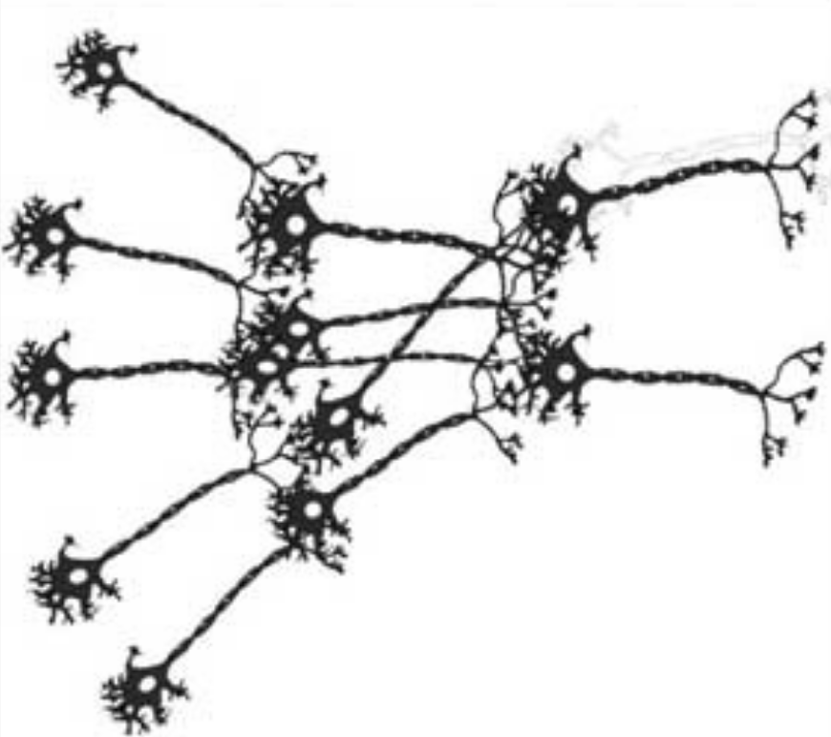
Development and Experience
Synapse Rearrangement: Synaptic connections are pruned, rearranged, and proliferated
Driven by experience
‘Use it or lose it’ versus ‘Neurons that fire together, wire together’
If presynaptic activity consistently drives a postsynaptic neuron, the synapse strengthens
If it fails to activate the postsynaptic cell, the synapse weakens and may die
This drives synaptic rearrangement in early development, but continues throughout life
Hypothesized to reflect learning

Slide 28
Development and Experience
Synapse Rearrangement
Facilitated through experience in development and across the lifespan
Learning new knowledge will form new synapses and strengthen existing ones
Networks of neurons formed through learning are hypothesized to reflect an internal representation of knowledge
E.g., this collection of neurons and their connections represents an apple

Slide 29
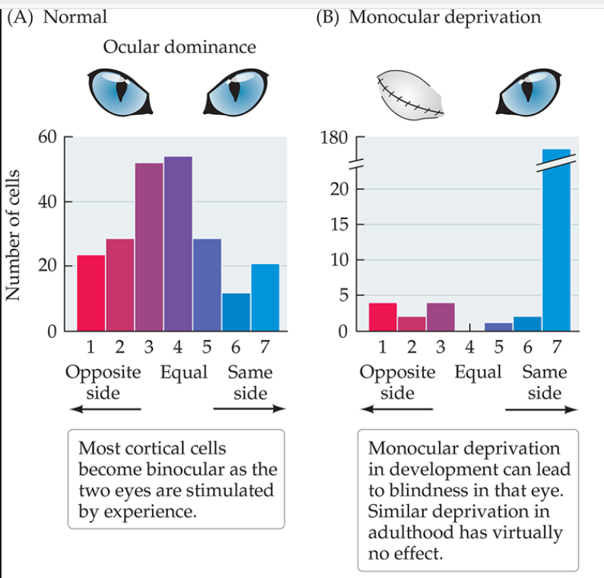
Development and Experience
Long-Term Potentiation/Depression
Schmidt et al., 2002
Research Question: Does lack of visual experience in one eye drive synaptic rearrangement in visual cortex?
Task: One of a cat’s eyes is occluded, depriving visual stimulation. Axonal patterns traced with in visual cortex
IV: Visual experience (normal vs. monocular deprivation)
DV: Synaptic Territory/ Number of cells

Slide 30
Development and Experience
Long-Term Potentiation/Depression
Schmidt et al., 2002
Results:
Open eye expands cortical territory
Deprived eye synapses retract
Open eye took over deprived eye territory since they are in competition
Conclusion: Experience drives synaptic rearrangement
Active inputs strengthen and spread, inactive inputs lose territory

Slide 31
Lecture Outline
Stages of Development
Development and Experience
Epigenetics and Experience

Slide 32
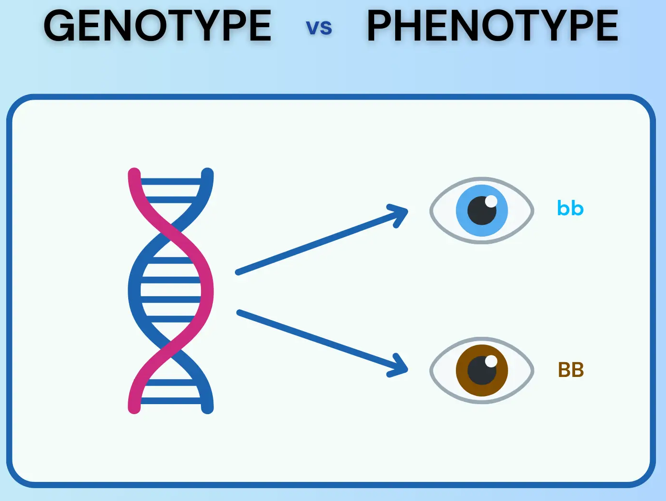
Genetics
Genotype: Sum of all genetic information that an individual inherits
Determined at fertilization
Gene Expression: A gene’s influence on a cell occurs when it is transcribed
Phenotype: Sum of all physical characteristics of an individual
Changes across the lifespan
An interaction between genotype and experience

Slide 33
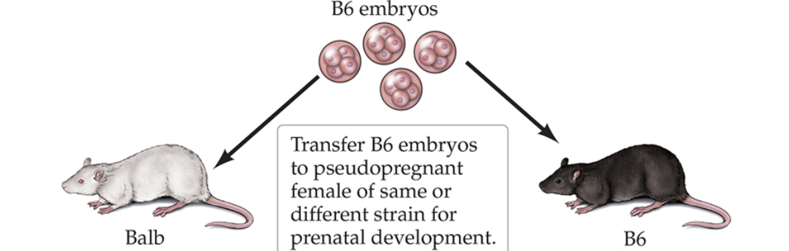
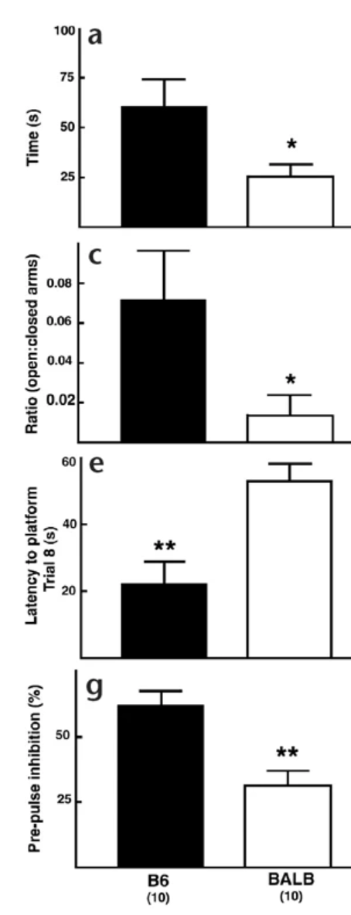
Epigenetics and Experience
Nature: All cells have the same genetic blueprint
Nurture: Genes that are expressed depends on environment and activity
Experience doesn’t change DNA, but changes how genes are used

Slide 34
Epigenetics and Experience
Gene Expression: Activation of a gene, which results in the production of a specific protein
Only a subset of genes is activated in a cell at a given time
Regulated by experience
Does not change DNA sequence

Slide 35
Epigenetics and Experience
Francis et al., 2003
Research Question: Does maternal environment alter gene expression and behavior in genetically identical mice?
Method: Genetically identical B6 embryos implanted into foster mothers (B6 or BALB)
Pups raised by foster mothers and behavior tested at 3 months
Completed a Morris water maze learning task and an open field anxiety task

Slide 36
Epigenetics and Experience
Francis et al., 2003
Independent Variable (IV):
B6 mothers: Same strain as pups, normal mouse behaviours
BALB mothers: Specifically bred type of mice that show higher anxiety, slower learning, less curiosity

Slide 37
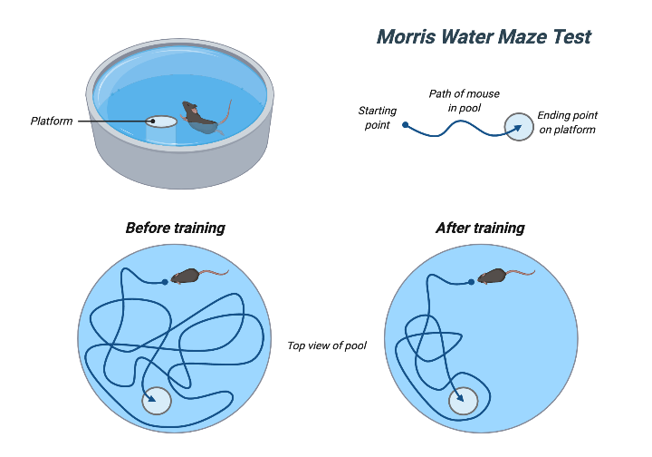
Epigenetics and Experience
Francis et al., 2003
Dependent Variable (DV):
Morris water maze
Latency to platform

Slide 38
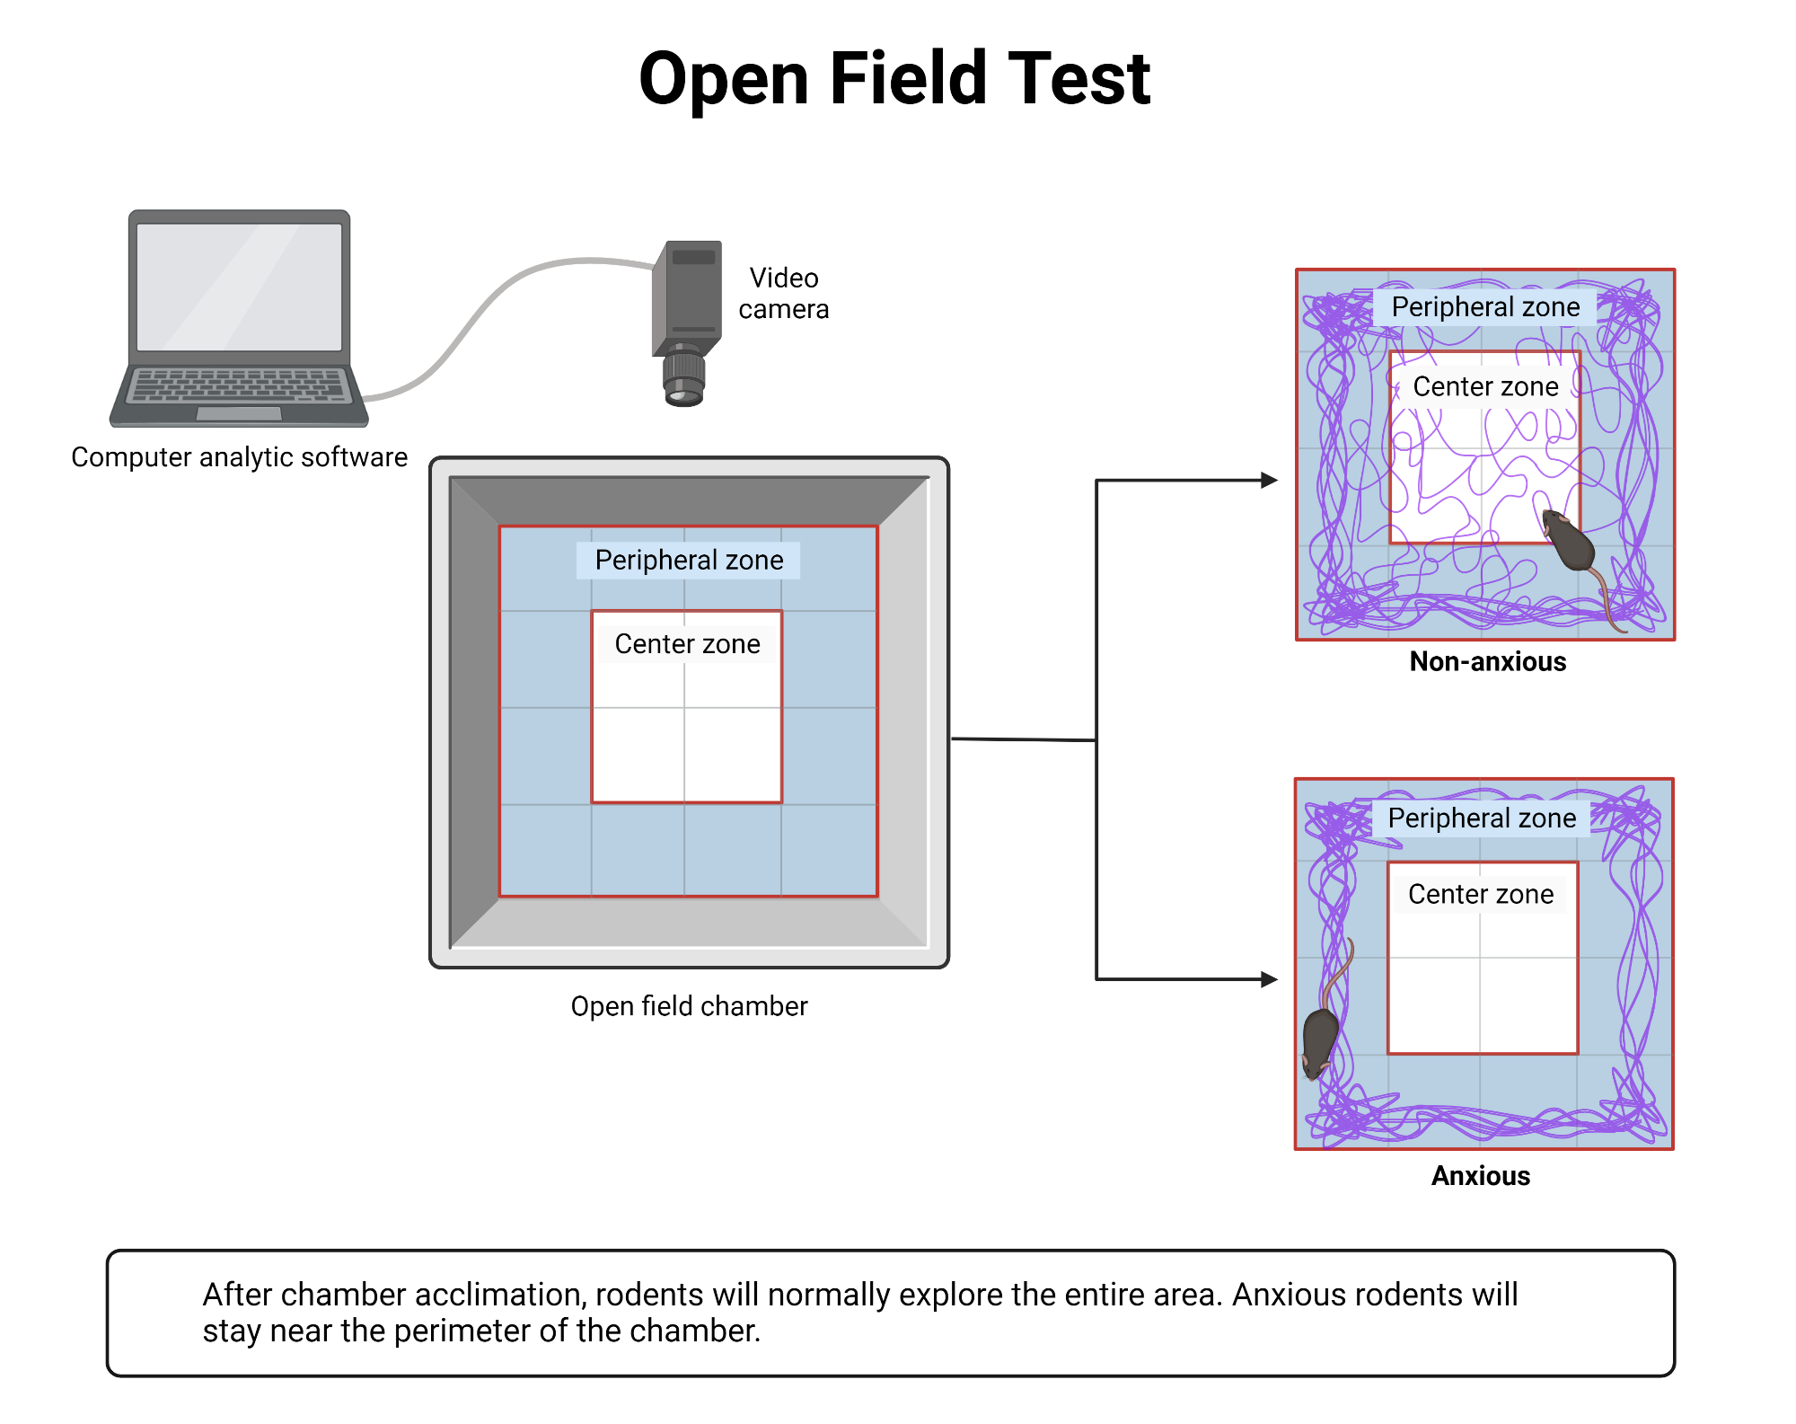
Epigenetics and Experience
Francis et al., 2003
Dependent Variable (DV):
Open field task
Time spent in the open (center zone)

Slide 39
Epigenetics and Experience
Francis et al., 2003
Results:
BALB-raised mice took longer in the Morris water maze, indicated poorer learning
BALB-raised mice spent less time in the center zone of the open field task, indicating more anxiety
Morris Water Maze
Open Field Task
B6 Mice
Balb Mice
B6 Mice
Balb Mice

Slide 40
Epigenetics and Experience
Francis et al., 2003
Conclusion: Environment (nurture) regulates gene expression and behaviour
The mice were genetically identical (nature)
The maternal care changed gene expression that led to differences in behaviour

Slide 41

Testable Figures
Slide 6
Slide 12
All figures corresponding to the results of a study are testable material.

